Slide 1


PROJECT ON JOBSPACE
Prepared By:
Arbeen Timilsina (6-2-530-5-2020)
Shisham Poudel(6-2-530-30-2020)

Slide 2
Table of Contents
Introduction
Problem Statement
Objectives
Scope
Background Study and Literature Review
Functional Requirements
Non functional Requirements
Tools and Technology
Expected Outcome
References

Slide 3
Introduction
Jobspace helps to find Jobs to the jobseekers according to theirs skills
Provides wide range of Job Vacancies according to the category
It allows for the management and updates of information from both job seekers and companies.
Registered employers have the ability to publish vacancy details and search for candidates based on key skills.
The service aims to efficiently connect job seekers with suitable job opportunities.
It offers a user-friendly platform for both job seekers and employers.
Saves time and cost of both parties

Slide 4
Problem Statement
The job market is more difficult for job seekers.
Recruitment is done manually
Traditional methods of job searching can be time consuming

Slide 5
Objectives
To create a platform where job seekers can easily find their respective jobs.
To act as a bridge between job seekers and employers.

Slide 6
Scope
It communicates between job seekers and the company.
It helps jobseekers to find the suitable job based on their skills and experience
It should manage all the information of employer such as personal, professional or educational details.
A Company can select a capable candidate in less time

Slide 7
Background Study
Existing systems
1. JobAxle.com[1]
Some of the disadvantages of the JobAxle.com are listed below:
Poor UI design.
A site with No job listing.
Not particularly a job portal but a mixture of all stuff.

Slide 8
Continue…
2. Kantipurjob.com[2]
Very Less Jobs Listing
Too many confusing stuffs
Very Less Engagement

Slide 9
Continue…
3. Easyjoblink.com.np[3]
Very Less Jobs Listing
Too many confusing stuffs
Very Less Engagement

Slide 10
Literature Review
Enhance job matching
Job seekers tend to find employment more quickly and earn higher salaries.
Employers benefit by being able to source candidates more effectively and at a lower cost.
User Experience affects engagement

Slide 11
Functional Requirements
Jobseeker shall register
Jobseeker shall login to the system
Everyone shall be able to view the jobs
Jobseekers shall be able to upload their CV/Resume
Jobseekers shall be able to search the jobs.
Jobseekers shall be able to apply for the job
Everyone shall be able to view the applied jobs
Company and Admin shall view the CV/Resume
Company shall view if their posted jobs have been applied

Slide 12
Continue…
Admin shall approve the jobs
Admin shall add the companies

Slide 13
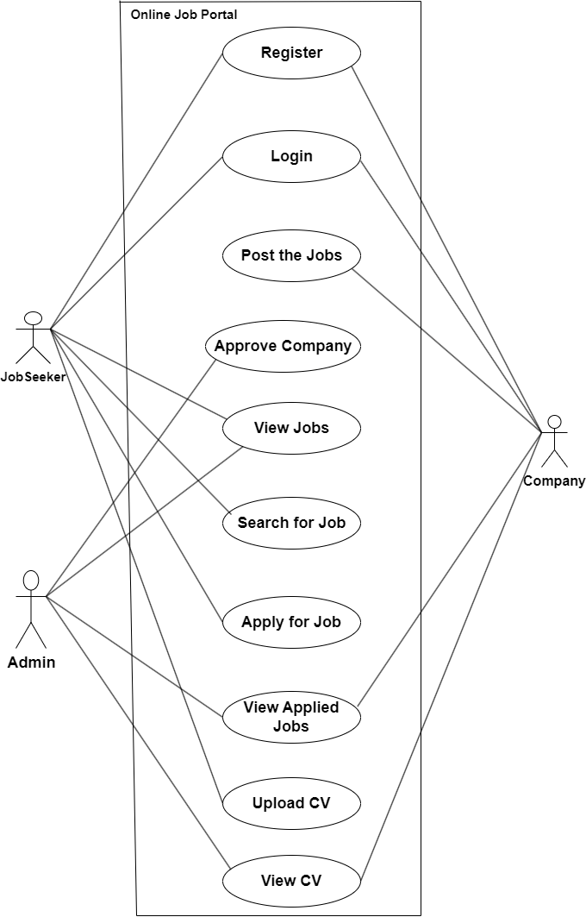
Use-case diagram

Slide 14
Non-functional Requirements
The system must have simple and user-friendly UI
The system must have a good response
The system must be compatible with different systems and devices
The system must be maintainable with clear documentation

Slide 15
Tools and Technology
Laragon
Visual Studio Code
Snipping Tool
Microsoft Word

Slide 16
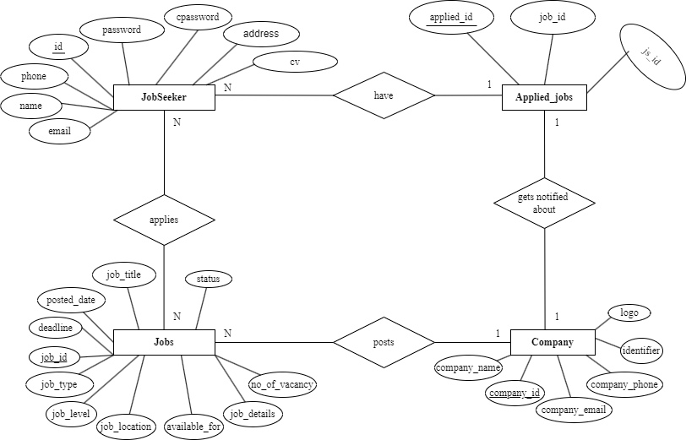
ER Diagram

Slide 17
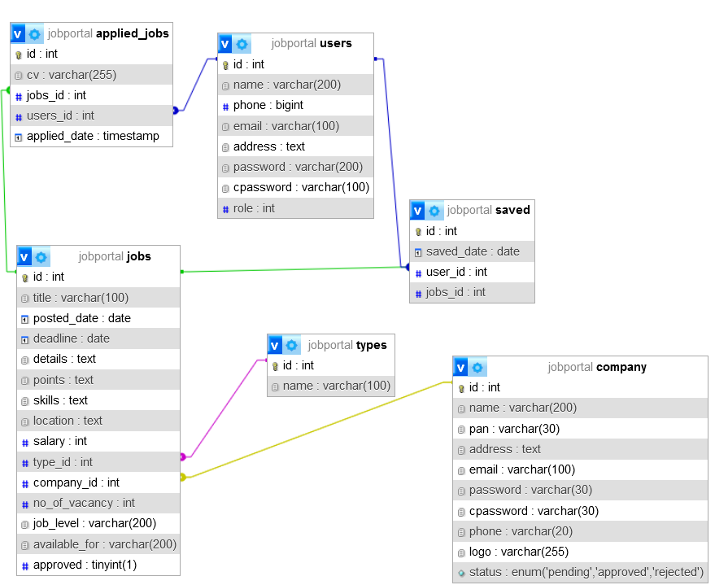
Database schema

Slide 18
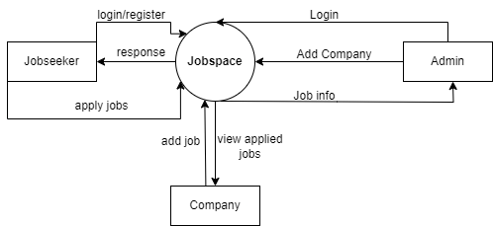
Process modeling
Level 0 DFD

Slide 19
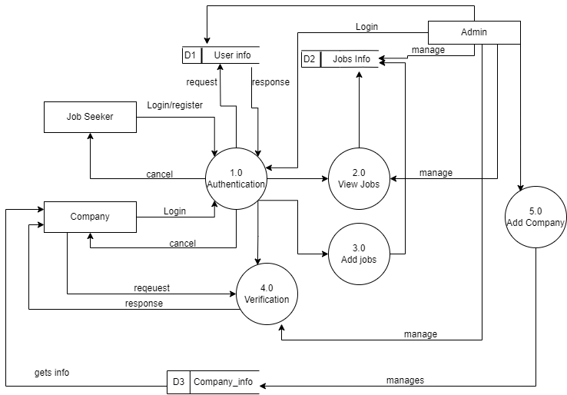
Level 1 DFD

Slide 20
Expected Outcomes
Beneficial to both Job Seekers and Companies
Will make the hiring process efficient and transparent
Job seeker will have access to relevant jobs and more options
Employers will have access to larger pool of qualified candidates
Potential to revolutionize the Job search process of Nepal

Slide 21
References
[1] JobAxle, "Jobaxle a step and beyond," 17 07 2019. [Online]. Available: https://jobaxle.com/.
[2] [Online]. Available: https://kantipurjob.com/.
[3] [Online]. Available: https://www.easyjoblink.com.np/.

Slide 22
Thank You
Any Queries?

